Slide 1

US City choice according to LOW nuclear impact and minimized air pollution with parameterized geospatial functions based on user input
Presentation on the ArcGIS platform

Slide 2
General project goal
US City choice according to low nuclear impact and minimized air pollution with parameterized geospatial functions based on user input
Estimation of nuclear hazard:
Air pollution risks:
1
PM10 particles in the air
1
Location of Nuclear Power Plants
2
Location of Coal Power Plants
2
Locations of “known” Nuclear Test Sites
3
Location of Gaz Power Plants
Major cities:
Be able to produce a dynamic map based on the user preferences (live at 100 miles of a Nuclear PP, Air pollution < 10% of 10micro particles, etc.…) to show all cities fulfilling all requirements and next choose the best city(ies) (vacancy, population).
1
Population
2
Home vacancy

Slide 3
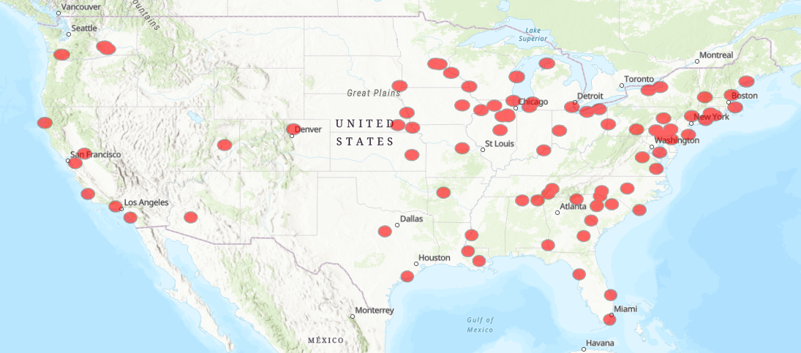
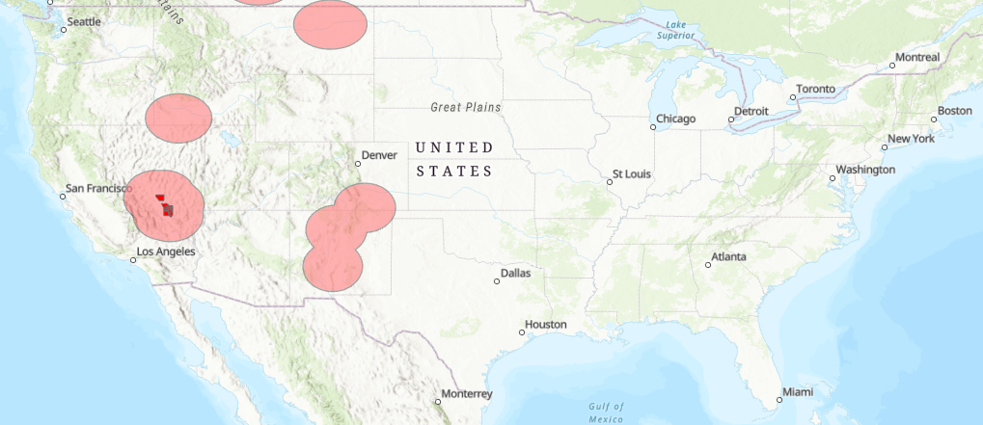
NUCLEAR HAZARD - data
Nuclear Power Plants throughout the US
# Buffers around Nuclear Power Plants
arcpy.Buffer_analysis("C:/Thomas_Calvet_City_Choice/City_Choice_In_Python/data/USA_NPP.shp",
"USA_NPP_Buffer", NPP_D,"","", "ALL","")
US Known tests sites
# Buffers around Nuclear Tests Sites
arcpy.Buffer_analysis("C:/Thomas_Calvet_City_Choice/City_Choice_In_Python/data/USA_NTS.shp",
"USA_NTS_Buffer", NTS_D,"","", "ALL","")

Slide 4
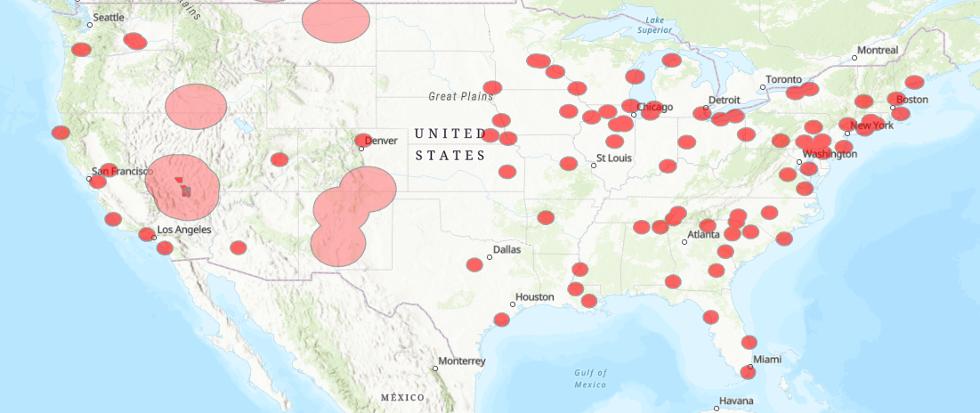
NUCLEAR HAZARD - data
Nuclear Power Plants throughout the US
US Known tests sites
Union of multiple layers (Buffers)
# Union of buffers around Nuclear Tests Sites & Nuclear Power Plants (Nuclear Risks)
inFeatures = [["USA_NPP_Buffer"], ["USA_NTS_Buffer"]]
arcpy.Union_analysis(inFeatures, "USA_Nuclear_Risk")

Slide 5
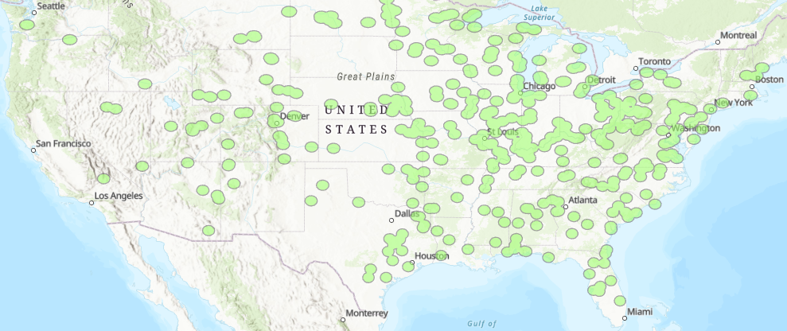
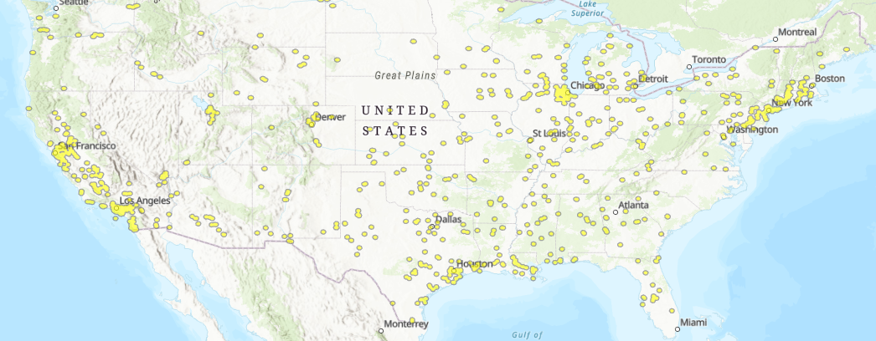
AIR QUALITY - data
Coal Power Plants
# Buffers around Coal Power Plants
arcpy.Buffer_analysis("C:/Thomas_Calvet_City_Choice/City_Choice_In_Python/data/USA_CPP.shp",
"USA_CPP_Buffer", CPP_D,"","", "ALL","")
Gas Power Plants
# Buffers around Gas Power Plants
arcpy.Buffer_analysis("C:/Thomas_Calvet_City_Choice/City_Choice_In_Python/data/USA_GPP.shp",
"USA_GPP_Buffer", GPP_D,"","", "ALL","")

Slide 6
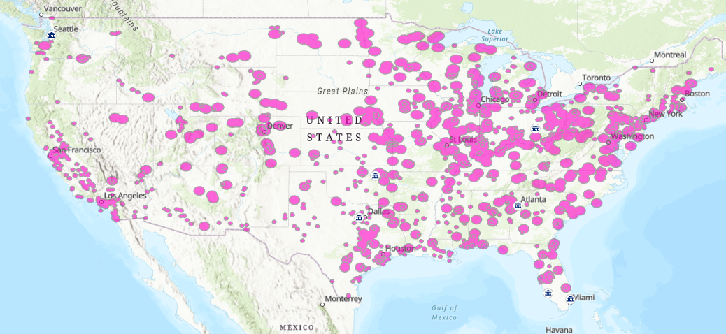
AIR QUALITY - data
CPP
GPP
Union of multiple layers (Buffers)
# Union of buffers around Gas & Coal Power Plants (Human Risks)
inFeatures = [["USA_CPP_Buffer"], ["USA_GPP_Buffer"]]
arcpy.Union_analysis(inFeatures, "USA_Human_Activities_Air_Pollution")

Slide 7
GENERAL risks - MAP
USA_Nuclear_Risk
USA_Human_Activities_Air_Pollution
# Union of all buffers (Total Risk USA)
inFeatures = [["USA_Nuclear_Risk"], ["USA_Human_Activities_Air_Pollution"]]
arcpy.Union_analysis(inFeatures, "USA_Total_Risks_Areas")

Slide 8
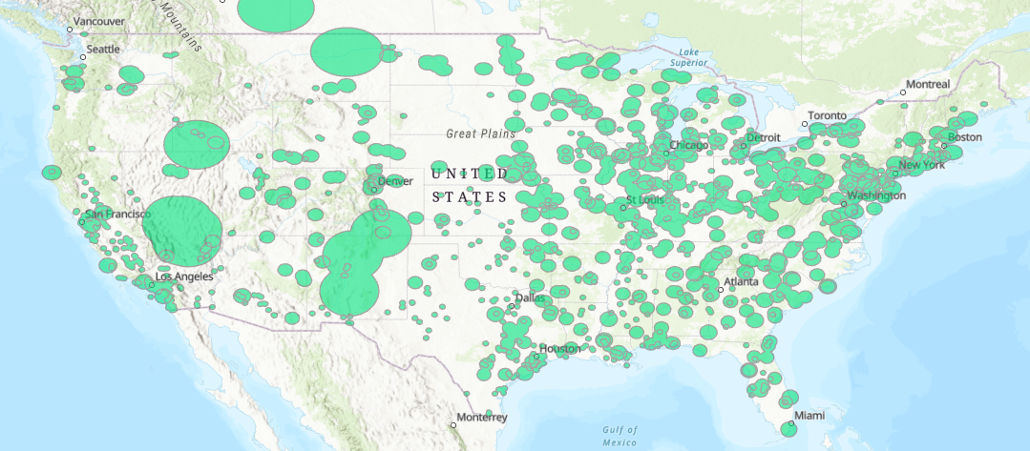
GENERAL risks - MAP
“Worst” areas to live due to bad air quality or high nuclear risk

Slide 9
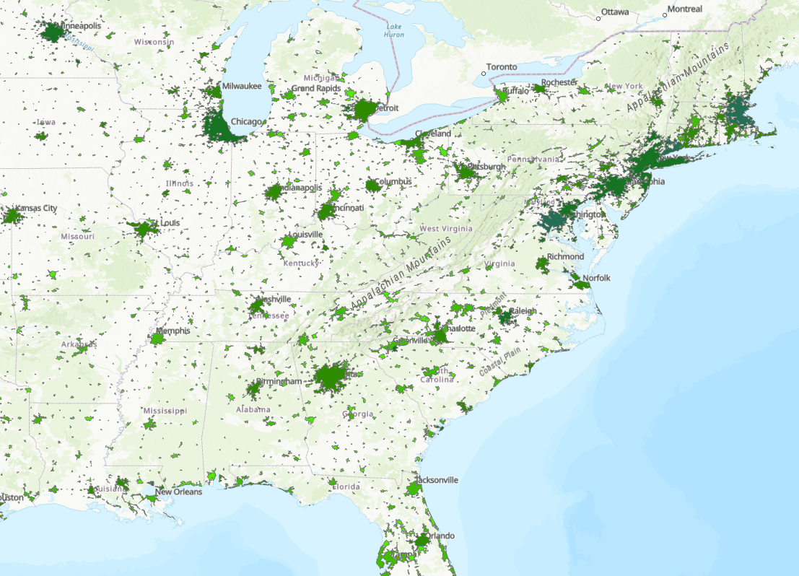
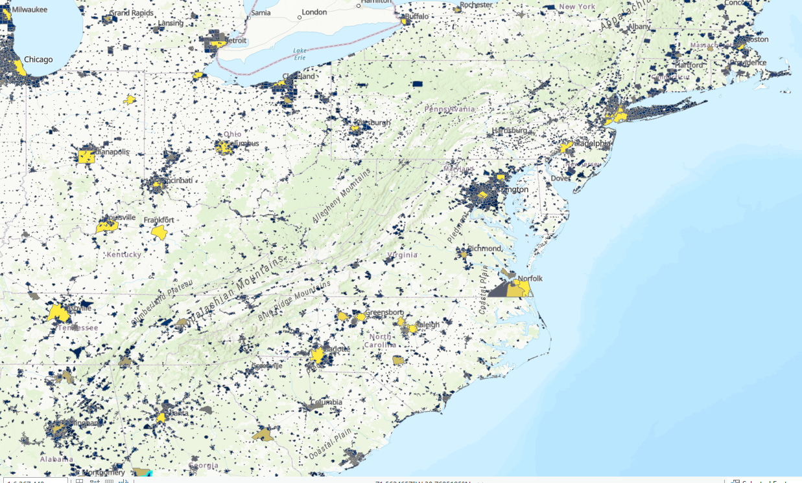
CITIES - data
Home vacancy
Major cities:
1
Population
2
Home vacancy
Population

Slide 10
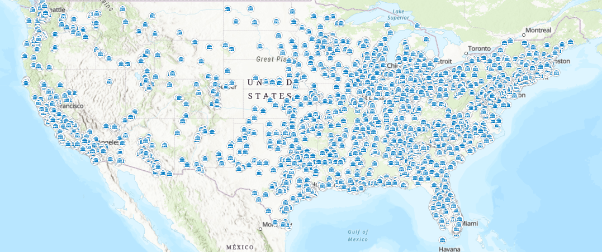
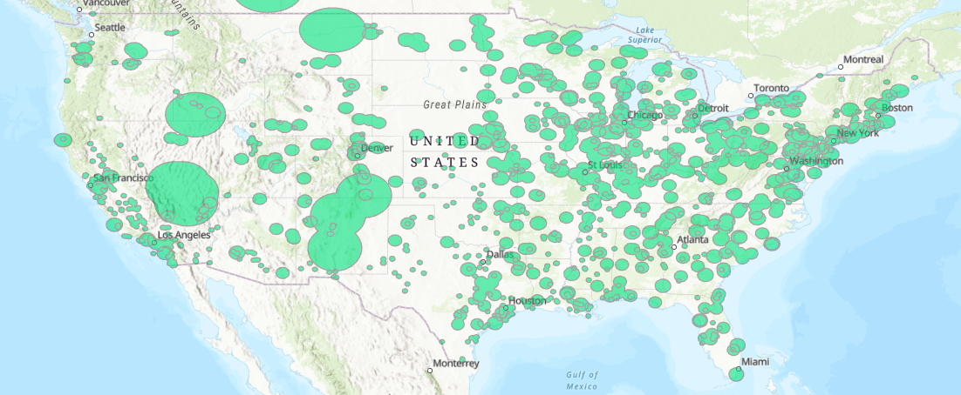
CITIES situation
To complete the project aim we must introduce “all major cities” of the USA and get rid of the ones in the high risks areas.
# Remove all the cities that are into USA_Total_Risks_Areas
inFeatures = "C:/Thomas_Calvet_City_Choice/City_Choice_In_Python/Major_Cities_US/USA_Major_Cities.shp"
erase_features = "USA_Total_Risks_Areas"
arcpy.Erase_analysis(inFeatures, erase_features, "Less_Polluted_Cities")

Slide 11
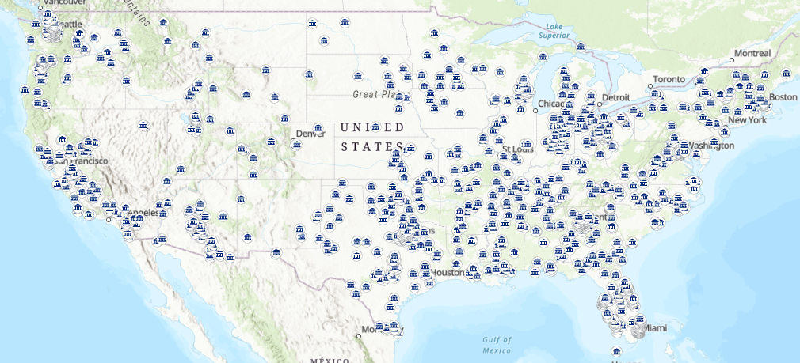
Cities to live in –1st PART
“Best” cities to live in (better air quality and low nuclear risk)

Slide 12
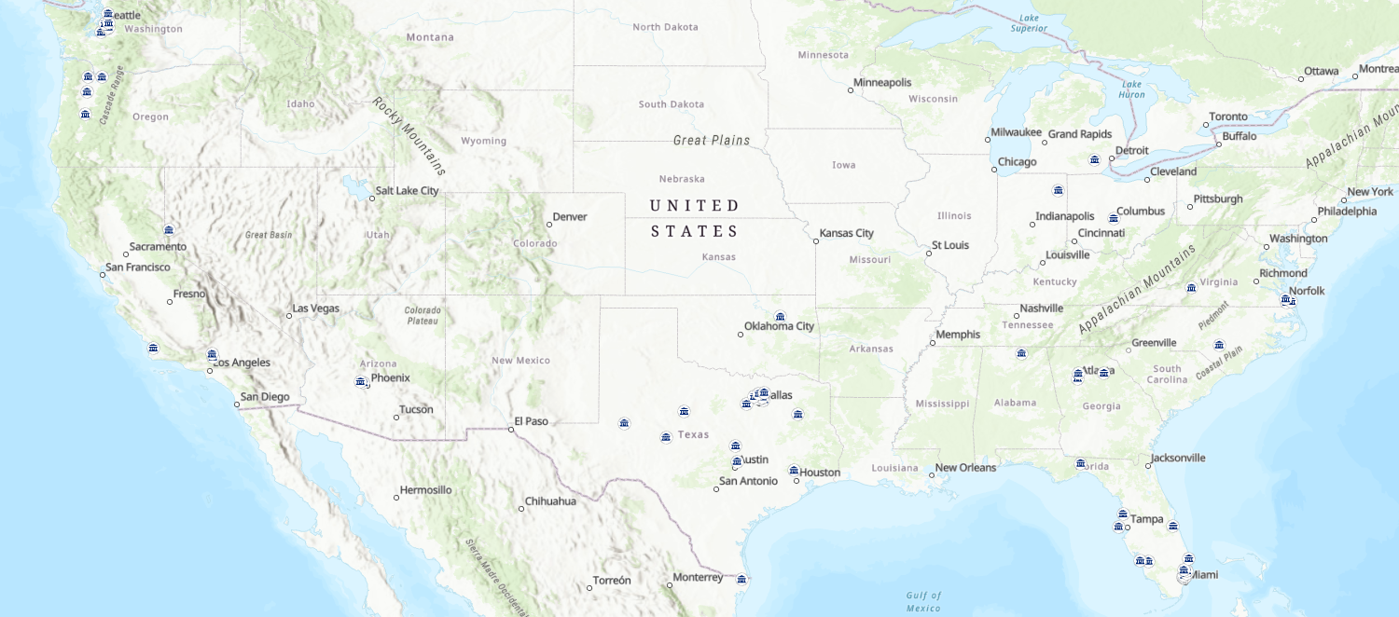
Cities to live in –2nd PART
# Select only cities that are outside the risks areas
# AND have a population count higher of a user entered parameter
inFeatures = "Less_Polluted_Cities"
outLocation = "C:/Thomas_Calvet_City_Choice/City_Choice_In_Python/City_Choice_In_Python.gdb"
outFeatureClass = "Less_Polluted_Cities_Population"
delimitedField = arcpy.AddFieldDelimiters("C:/Thomas_Calvet_City_Choice/City_Choice_In_Python/Major_Cities_US/USA_Major_Cities.shp",
"POPULATION")
expression = "POPULATION >" + str(Population)
arcpy.FeatureClassToFeatureClass_conversion(inFeatures, outLocation, outFeatureClass, expression)
After getting the best cities of the US in terms of low risks areas, the point is to find dynamic cities with enough population and the highest vacant home as possible.
Tool: Feature Class to Feature Class
Expression: population>=100000

Slide 13
Cities to live in –2nd PART
# Select only cities that are outside the risks areas
# AND have a population count higher of a user entered parameter
# AND have a vacancy rate higher than a user entered parameter
inFeatures = "Less_Polluted_Cities_Population"
outLocation = "C:/Thomas_Calvet_City_Choice/City_Choice_In_Python/City_Choice_In_Python.gdb"
outFeatureClass = "Less_Polluted_Cities_Population_Vacancy"
delimitedField = arcpy.AddFieldDelimiters("C:/Thomas_Calvet_City_Choice/City_Choice_In_Python/Major_Cities_US/USA_Major_Cities.shp",
"VACANT")
expression = "VACANT >" + str(Vacancy)
arcpy.FeatureClassToFeatureClass_conversion(inFeatures, outLocation, outFeatureClass, expression)
The last criterion is the vacancy by cities:
Tool: Feature Class to Feature Class
Expression: vacant>=15000

Slide 14
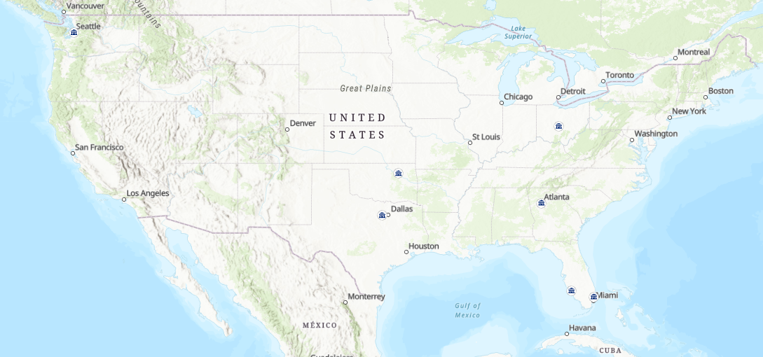
Cities to live in –2nd PART
“Best” cities to live in according to user entered parameters

Slide 15

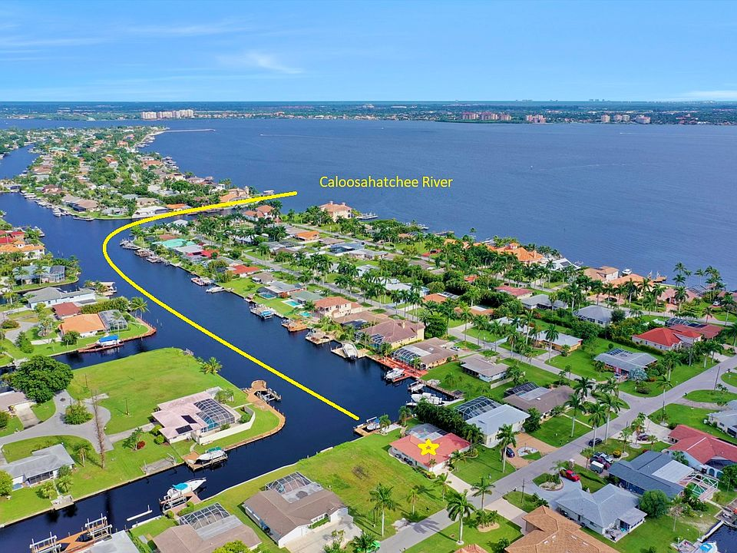





Final results - Unsorted
We finally succeeded in finding cities that are dynamic, with potential and with houses to buy.. Here’s the list!
It is not sorted, perhaps we want to find THE city! (Sort must be done)
Name: Fort Lauderdale
Population: Around 180k
Vacancy: Over 18k
Name: Cape Coral
Population: Around 180k
Vacancy: Over 18k
Name: Fort Worth
Population: Around 850k
Vacancy: Over 28k
Name: Atlanta
Population: Around 460k
Vacancy: Over 39k
Name: Tulsa
Population: Around 420k
Vacancy: Over 21k
Name: Columbus
Population: Around 870k
Vacancy: Over 39k
Name: Seattle
Population: Around 690k
Vacancy: Over 25k

Slide 16
Final results - sorted
Sort all results according to a field
1
3
Name: Columbus
Population: Around 870k
Vacancy: Over 39k
Name: Seattle
Population: Around 690k
Vacancy: Over 25k
# Sorting all cities from the final table according to their population
in_dataset = "Less_Polluted_Cities_Population_Vacancy"
out_dataset = "Less_Polluted_Cities_Population_Vacancy_Ranked"
sort_field = [[str(Field), str(Method)]]
sort_method = "PEANO" # space filling curve algorithm
arcpy.Sort_management(in_dataset, out_dataset, sort_field, sort_method)
2
Name: Fort Worth
Population: Around 850k
Vacancy: Over 28k

Slide 17
HOW TO USE – CITY CHOICE
CityChoice("C:/Thomas_Calvet_City_Choice/City_Choice_In_Python/City_Choice_In_Python.gdb",
"USA_NPP", “A miles",
"USA_NTS", “B miles",
"USA_GPP", “C miles",
"USA_CPP", “D miles",
E, F,
“FIELD", “METHOD")
User parameters:
A = Distance from Nuclear Power Facilities
B = Distance from Nuclear Tests Sites
C = Distance from Gas Power Plants
D = Distance from Coal Power Plants
E = Minimum population of the city
F = Empty houses (Vacant)
FIELD = POPULATION // VACANT
METHOD = ASCENDING // DESCENDING

Slide 18
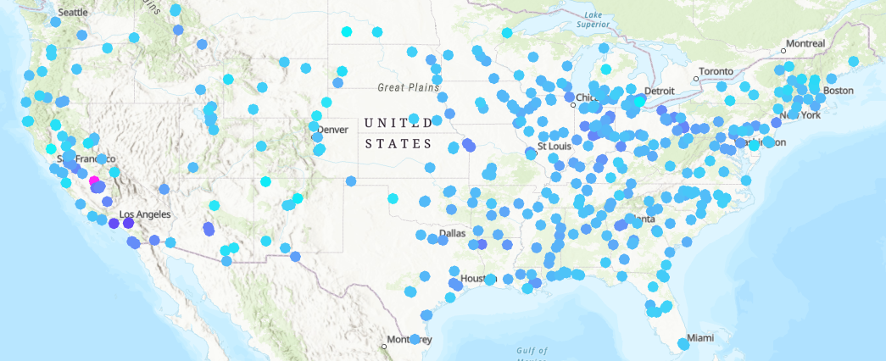
Improvements
Nuclear Power Plants
Air pollution PM
1. Get all values of power capacity for each NPP
Inside the NPP data shapefile
2. Add a field
3. Add delimitations
for FID in USA_NPP
if “grosspower” =< 500:
addtoBufferRadiusfield(“grosspower”*1.5)
elif grosspower > 501 AND grosspower < 850:
addtoBufferRadiusfield(“grosspower”*2.5)
else:
addtoBufferRadiusfield(“grosspower”*3.5)
end for
3. Do the buffers according to the new field and not a fixed value (BufferRadiusfield)
1. Get all values of PM pollution for all cities in US
Code : Extract value to points
ExtractValuesToPoints(inPointFeatures, inRaster, outPointFeatures,"INTERPOLATE", "VALUE_ONLY")
2. Add the values obtained in a new field
Code: Add Field
arcpy.AddField_management(inFeatures, fieldName1, "LONG", fieldPrecision, field_alias=fieldAlias, field_is_nullable="NULLABLE")
3. Then add the possibility to classify the cities at the end by their pollution levels

